Slide 1
Value
Time

Slide 2
We need a dual operating system for business agility
Efficiency and stability
Speed of Innovation

Slide 3
Apply set based approach
Multiple Design Options
Set-Based
Learning points
Time
Single option
Too much to adjust
Point-Based

Slide 4

Built-in quality practices for hardware teams
Support hardware qualities with exploratory, early iterations, frequent system level integration, design verification, Model-based systems Engineering(MBSE), and set-based design.
Component
Integration
System
Team
Component
Maturation

Slide 5

Agile Release Trains (ARTs)
A virtual organization of 5-12 teams(50-125+ individuals ).
Synchronized on a common cadence, a Program Increment (PI).
Aligned to a common mission via a single Program Backlog.
Continuous Delivery Pipeline
>
<
>
AGILE RELEASE TRAIN
<
>
<
Continuous Exploration
Continuous Integration
Continuous Deployment
Release on Demand

Slide 6
ARTs are organized to deliver value continually
Consider the necessary interaction between the teams and organize to maximize flow.
Agile Release Train
Stream Aligned
Complicated
Subsystem
Stream Aligned
Enabling
Stream Aligned
Platform

Slide 7
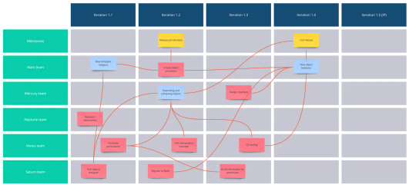
What is PI Planning?
Program Increment (PI) planning is a cadence-based, face-to-face event that serves as the heartbeat of the Agile Release Train (ART), aligning all teams on the ART to a shared mission and vision.
Two days every 8-12 weeks (typically 10 weeks).
Everyone plans together.
Product Management owns Features priorities.
Development teams own Story planning and high-level estimates.
Architect/ Engineering and UX work as intermediaries for governance, interfaces and dependencies.

Slide 8
Benefits of PI Planning
Establishing personal communication across all team members and stakeholders.
Fast decision-making
Identifying dependencies and fostering cross-team and cross-ART collaboration.
Matching demand to capacity, eliminating excess work-in-progress (WIP).
Providing the opportunity for just the right amount of architecture and Lean User Experience (UX) guidance.
Aligning development to business goals with the business context, vision and Team/Program PI objectives.

Slide 9

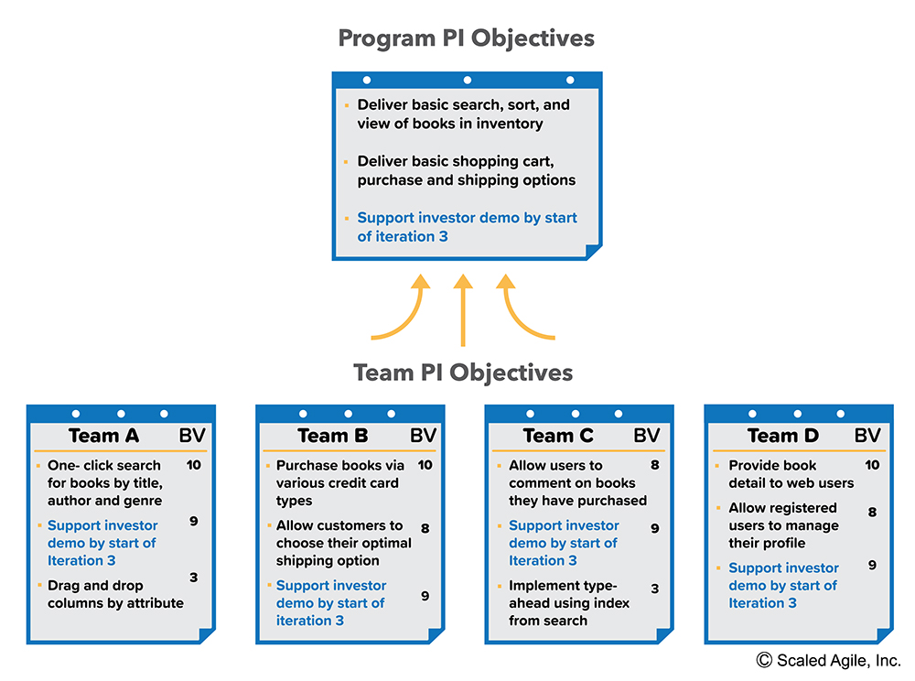

The PI Planning process
INPUT
OUTPUT
PI Planning
Top 10 Features
NFRs
Program Backlog
Vision and Top 10 Features
Team and Program PI Objectives and Program Board

Slide 10
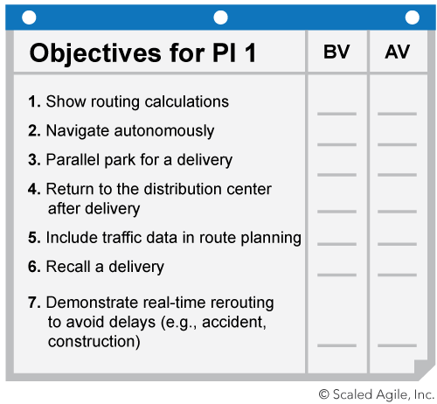
Create Alignment with PI Objectives
Objectives are business summaries of what each team intends to deliver in the upcoming PI.
They often directly relate to intended features in the backlog.
Other examples:
Aggregation of a set of Features.
A milestone like a trade show.
An Enabler feature supporting the implementation.
A major refactoring.

Slide 11
Maintain predictability with uncommitted objectives
Uncommitted objectives help improve the predictability of delivering business value.
They are planned and aren’t extra things teams do ‘just in case you have time.
They are not included in the commitment, thereby making the commitment more reliable
If a team has low confidence in meeting a PI Objective, it should be moved to uncommitted
If an objective has many unknowns, consider moving it to uncommitted and put in early spikes
Uncommitted objectives count when calculating load
Objectives for PI 1
Uncommitted Objectives
7. Spike: Reduce GPS signal loss by 25%.
8. Demonstrate real-time rerouting to avoid delays (e.g., accident, construction).

